Slide 1
Inventory Management System
Mika Griffith
Michael Lehman
Noah Philips
Mark Wells

Slide 2
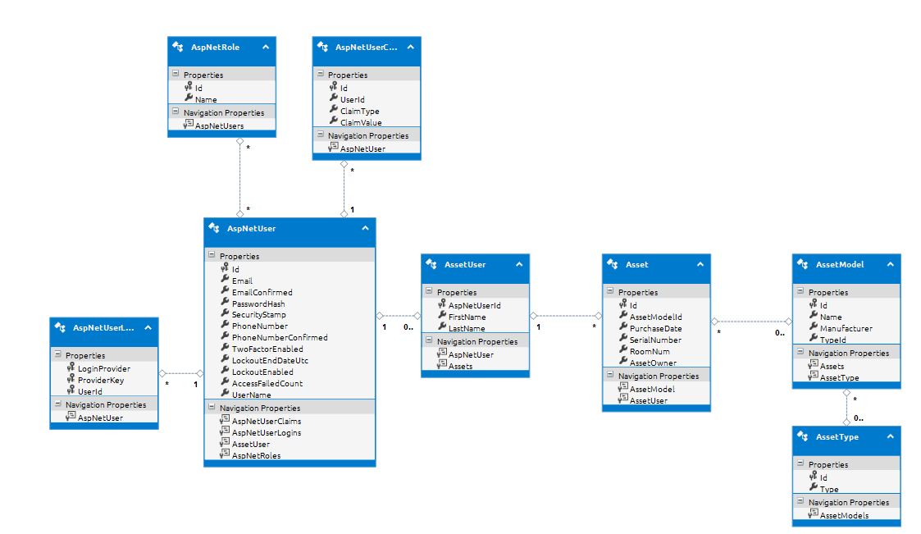
Class Model/EDMX

Slide 3
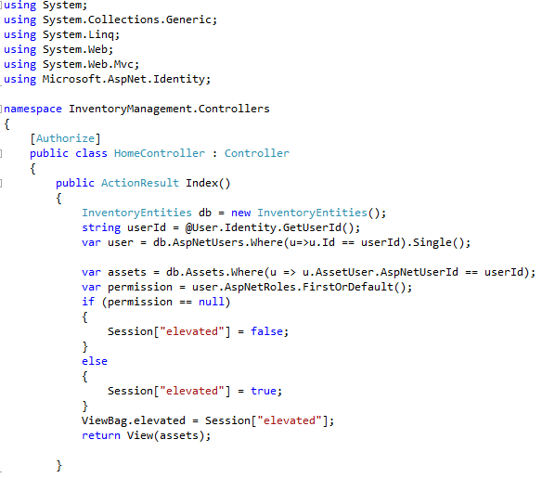
Home Controller

Slide 4
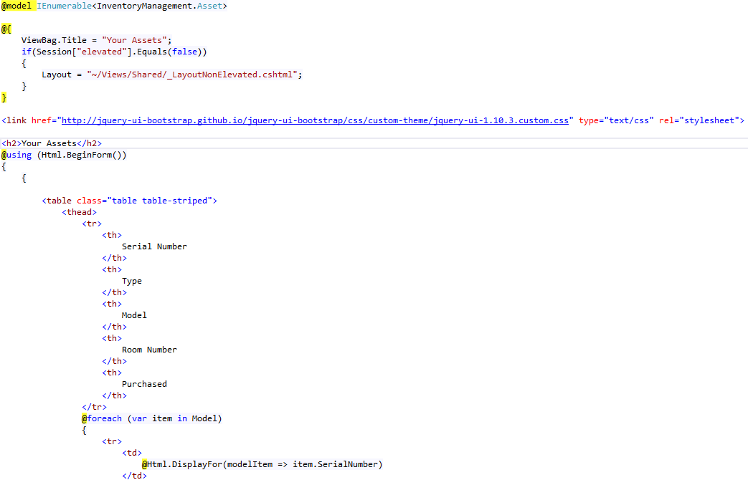
Index View

Slide 5
ORM – Entity Framework
Uses simple common syntax (LINQ) to Add/Read/Delete/Update objects.
No need to deal with writing much SQL
Handles object-relational mapping (ORM) on its own.
Builds scaffolding for controllers and views based on models

Slide 6
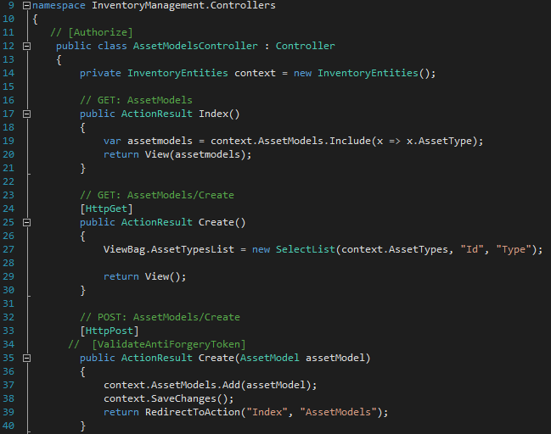
Asset Models – CRUD

Slide 7
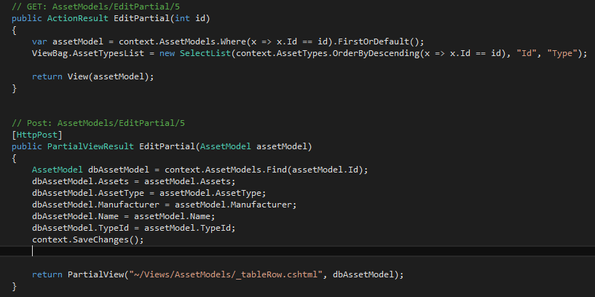
Asset Models - CRUD

Slide 8
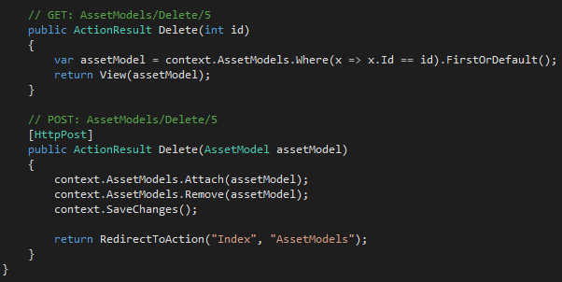
Asset Models - CRUD

Slide 9
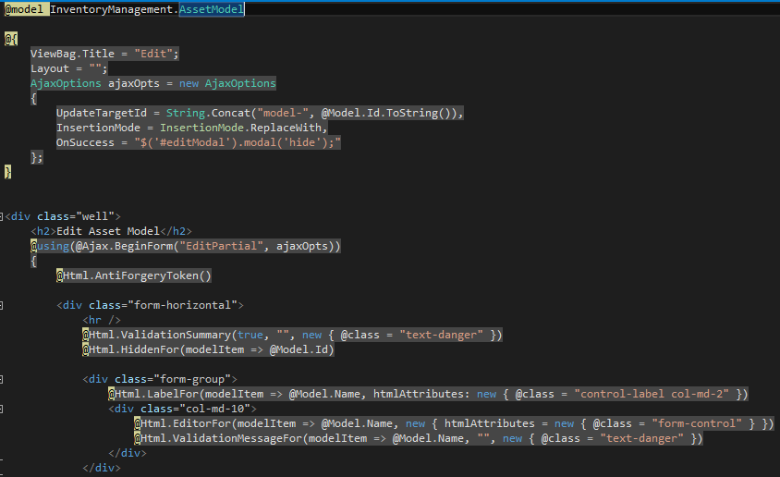
Asset Models – Edit View

Slide 10
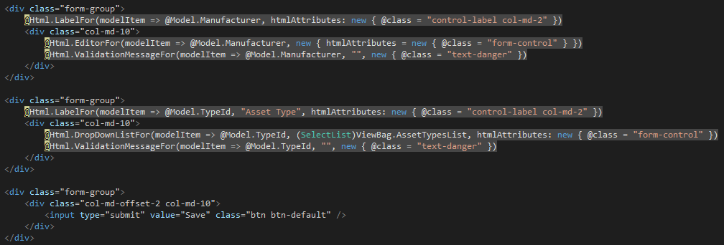
Asset Models – Edit View

Slide 11
Asset Search

Slide 12
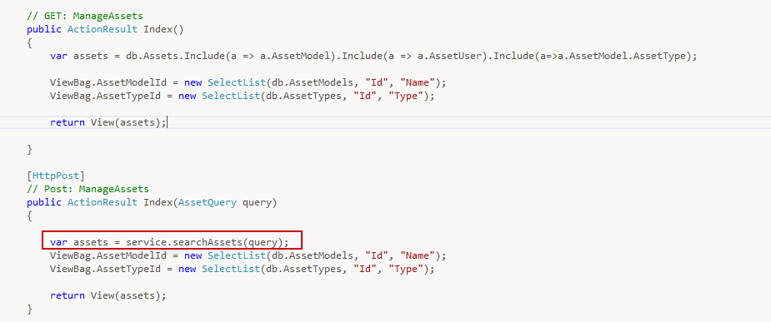
Controller

Slide 13
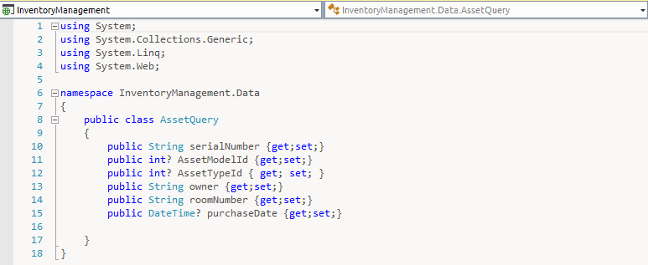
Query Class

Slide 14
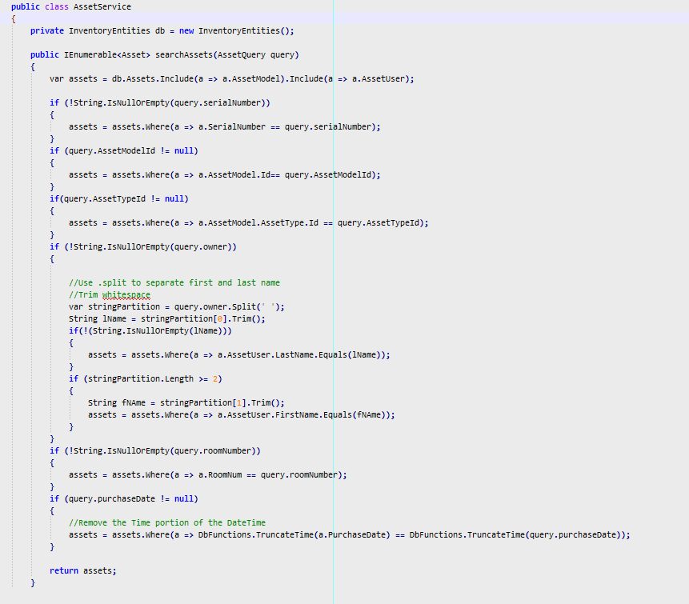
Search Logic

Slide 15
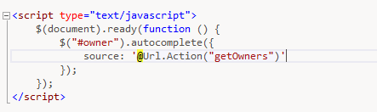
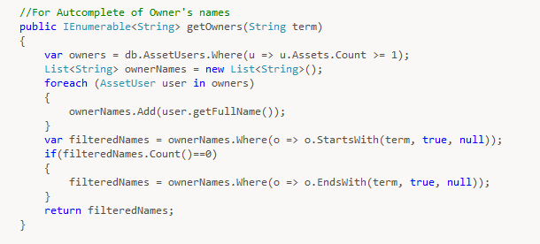
Autocomplete

Slide 16
Edit

Slide 17
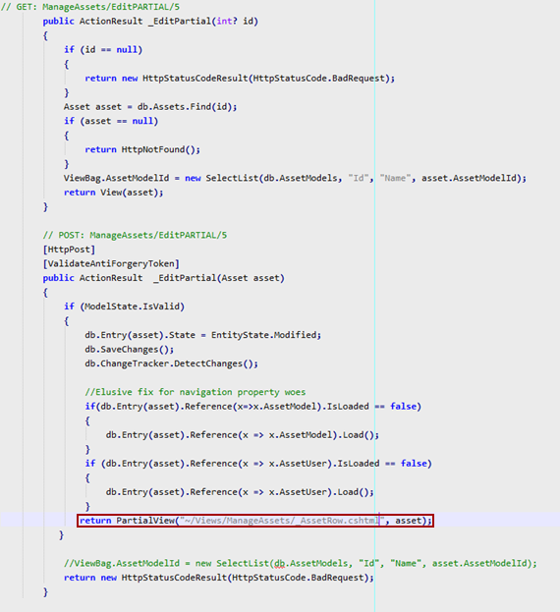
Controller

Slide 18
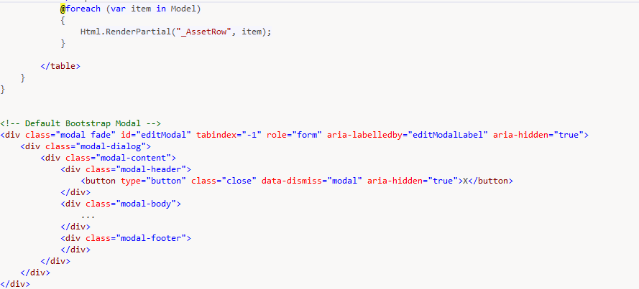
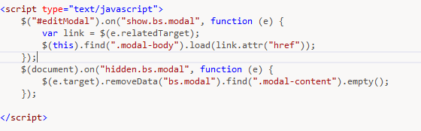
View – Partial Rows & Modal

Slide 19
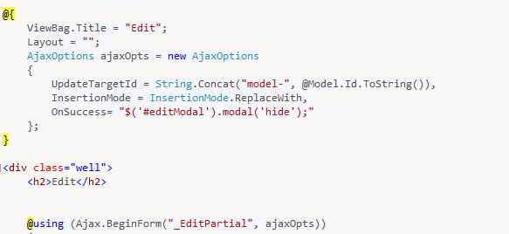
Ajax Form

Slide 20
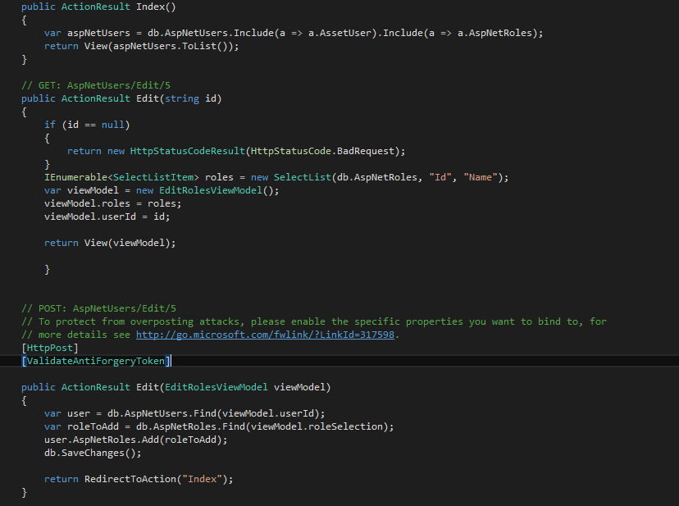
User Roles Page

